Slide 1
Computer Networks
Lecture 5: Ch2: Application Layer
Prepared and modified by:
Assoc.Prof.Dr. Hossam Mahmoud Moftah
Associate Professor – Faculty of Computers and Artificial Intelligence– Beni-Suef University

Slide 2
Chapter 2: outline
2.1 principles of network applications
  app architectures
  app requirements
2.2 Web and HTTP
2.3 FTP
2.4 electronic mail
  SMTP, POP3, IMAP
2.5 DNS
2.6 P2P applications
2.7 socket programming with UDP and TCP
Adapted from J.F Kurose and K.W. Ross March 2012
Application Layer
2-<number>

Slide 3
Web and HTTP
First, a review…
web page consists of objects
object can be HTML file, JPEG image, Java applet, audio file,…
web page consists of base HTML-file which includes several referenced objects
each object is addressable by a URL, e.g.,
www.someschool.edu/someDept/pic.gif
host name
path name
Adapted from J.F Kurose and K.W. Ross March 2012
Application Layer
2-<number>

Slide 4


HTTP overview
HTTP request
PC running
Firefox browser
HTTP response
HTTP request
server
running
Apache Web
server
HTTP response
iphone running
Safari browser
Adapted from J.F Kurose and K.W. Ross March 2012
Application Layer
2-<number>

Slide 5
HTTP overview (continued)
uses TCP:
client initiates TCP connection (creates socket) to server, port 80
server accepts TCP connection from client
HTTP messages (application-layer protocol messages) exchanged between browser (HTTP client) and Web server (HTTP server)
TCP connection closed
HTTP is “stateless”
server maintains no information about past client requests
Adapted from J.F Kurose and K.W. Ross March 2012
Application Layer
2-<number>

Slide 6
HTTP connections
non-persistent HTTP
at most one object sent over TCP connection
  connection then closed
downloading multiple objects required multiple connections
persistent HTTP
multiple objects can be sent over single TCP connection between client, server
Adapted from J.F Kurose and K.W. Ross March 2012
Application Layer
2-<number>

Slide 7
Non-persistent HTTP
suppose user enters URL:
(contains text,
references to 10
jpeg images)
www.someSchool.edu/someDepartment/home.index
1a. HTTP client initiates TCP connection to HTTP server (process) at www.someSchool.edu on port 80
1b. HTTP server at host www.someSchool.edu waiting for TCP connection at port 80. “accepts” connection, notifying client
2. HTTP client sends HTTP request message (containing URL) into TCP connection socket. Message indicates that client wants object someDepartment/home.index
3. HTTP server receives request message, forms response message containing requested object, and sends message into its socket
time
Adapted from J.F Kurose and K.W. Ross March 2012
Application Layer
2-<number>

Slide 8
Non-persistent HTTP (cont.)
4. HTTP server closes TCP connection.
5. HTTP client receives response message containing html file, displays html. Parsing html file, finds 10 referenced jpeg objects
time
6. Steps 1-5 repeated for each of 10 jpeg objects
Adapted from J.F Kurose and K.W. Ross March 2012
Application Layer
2-<number>

Slide 9
Non-persistent HTTP: response time
RTT (round-trip time (RTT)): time for a small packet to travel from client to server and back
HTTP response time:
one RTT to initiate TCP connection
one RTT for HTTP request and first few bytes of HTTP response to return
file transmission time
non-persistent HTTP response time =
  2RTT+ file transmission time
initiate TCP
connection
RTT
request
file
RTT
time to
transmit
file
file
received
time
time
Adapted from J.F Kurose and K.W. Ross March 2012
Application Layer
2-<number>

Slide 10
Persistent HTTP
non-persistent HTTP issues:
requires 2 RTTs per object
browsers often open parallel TCP connections to fetch referenced objects
persistent HTTP:
server leaves connection open after sending response
subsequent HTTP messages between same client/server sent over open connection
client sends requests as soon as it encounters a referenced object
as little as one RTT for all the referenced objects
Adapted from J.F Kurose and K.W. Ross March 2012
Application Layer
2-<number>

Slide 11
Persistent HTTP
Non-persistent HTTP issues:
Connection setup for each request
But browsers often open parallel connections
Persistent HTTP:
Server leaves connection open after sending response
Subsequent HTTP messages between same client/server are sent over connection
Persistent without pipelining:
Client issues new request only when previous response has been received
One RTT for each object
Persistent with pipelining:
Default in HTTP/1.1 spec
Client sends multiple requests
As little as one RTT for all the referenced objects
Server must handle responses in same order as requests

Slide 12
HTTP request message
two types of HTTP messages: request, response
HTTP request message:
  ASCII (human-readable format)
Compression methods
request line
(GET, POST,
HEAD commands)
GET /index.html HTTP/1.1\r\n
Host: www-net.cs.umass.edu\r\n
User-Agent: Firefox/3.6.10\r\n
Accept: text/html,application/xhtml+xml\r\n
Accept-Language: en-us,en;q=0.5\r\n
Accept-Encoding: gzip,deflate\r\n
Accept-Charset: ISO-8859-1,utf-8;q=0.7\r\n
Keep-Alive: 115\r\n
Connection: keep-alive\r\n
\r\n
header
lines
I prefer english US, but will accept other types of English
the character encodings
Adapted from J.F Kurose and K.W. Ross March 2012
Application Layer
2-<number>

Slide 13
HTTP request message
What does Keep-Alive mean?
  This means it is OK to keep the connection open to ask for more resources like for example images.
  What does q=0.5 mean?
  Each language-range may be given an associated quality value which represents an estimate of the user's preference for the languages specified by that range. The quality value defaults to "q=1".
  \r = CR (Carriage Return)
  \n = LF (Line Feed)
  \r\n = CR + LF // Used as a new line
Adapted from J.F Kurose and K.W. Ross March 2012
Application Layer
2-<number>

Slide 14
HTTP request message
  HTTP 1.1 allows you to have persistent connections which means that you can have more than one request/response on the same HTTP connection.
  In HTTP 1.0 you had to open a new connection for each request/response pair. And after each response the connection would be closed. This lead to some big efficiency problems because of TCP Slow Start.
Adapted from J.F Kurose and K.W. Ross March 2012
Application Layer
2-<number>

Slide 15
HTTP request message: general format
method
sp
URL
sp
version
cr
request
line
lf
header field name
value
cr
lf
~
~
header
lines
~
~
header field name
value
cr
lf
cr
lf
~
entity body
~
body
~
~
Adapted from J.F Kurose and K.W. Ross March 2012
Application Layer
2-<number>

Slide 16

Python’s Requests
  Making requests using the most common HTTP methods
  Steps:
    Installing the requests library
    Importing requests
    GET request
Adapted from https://realpython.com/python-requests/
Application Layer
2-<number>

Slide 17
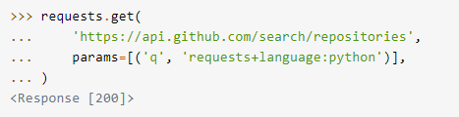
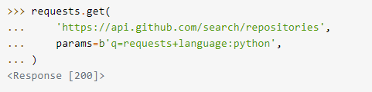
Python’s Requests
  Query String Parameters
    Pass values by bytes
Adapted from https://realpython.com/python-requests/
Application Layer
2-<number>

Slide 18
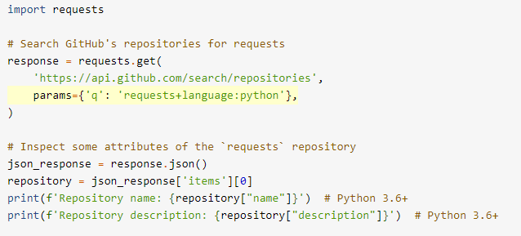
Python’s Requests
  Print parameters
  JSON (JavaScript Object Notation) is a lightweight data-interchange format. It is easy for humans to read and write. It is easy for machines to parse and generate.
Adapted from https://realpython.com/python-requests/
Application Layer
2-<number>

Slide 19
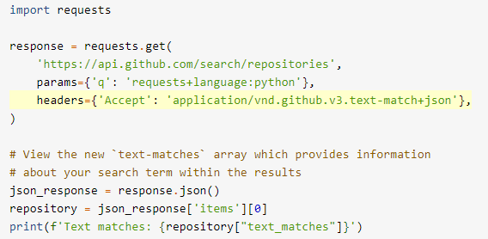
Python’s Requests
  Request Headers
  The Accept header tells the server what content types your application can handle.
Adapted from https://realpython.com/python-requests/
Application Layer
2-<number>

Slide 20
The end
Application Layer
2-<number>

